Slide 1
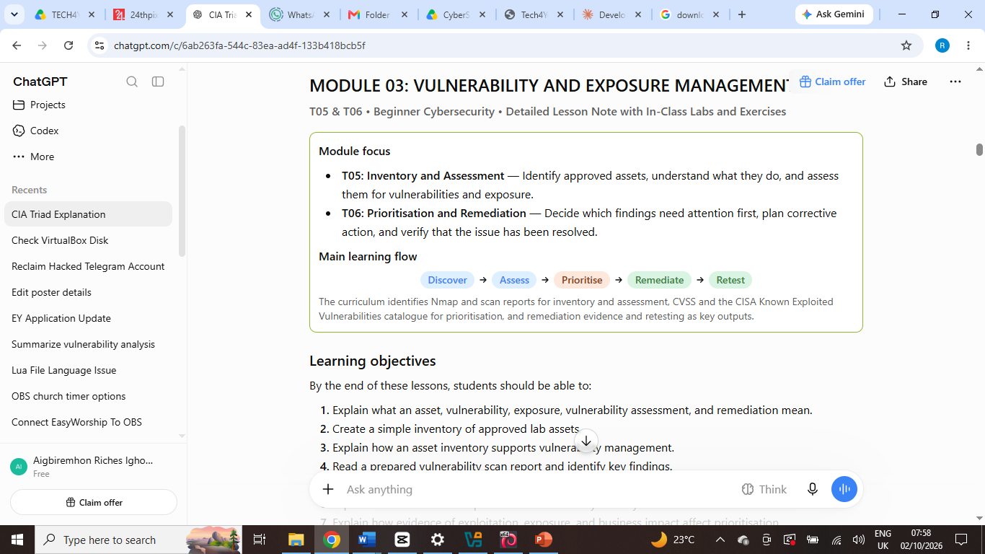

Slide 2
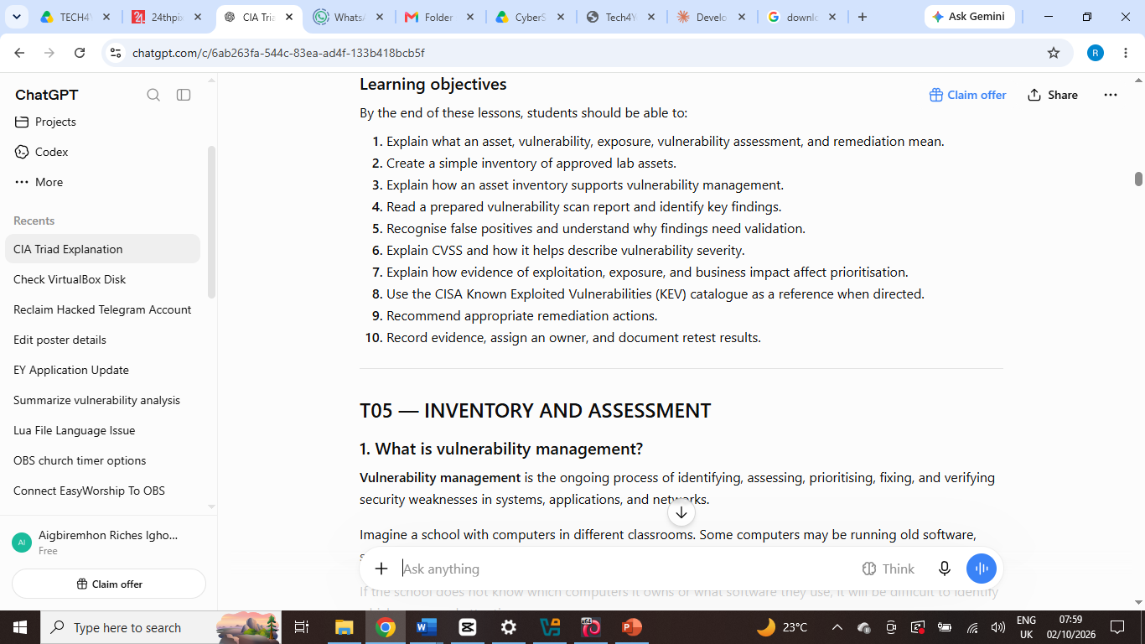

Slide 3
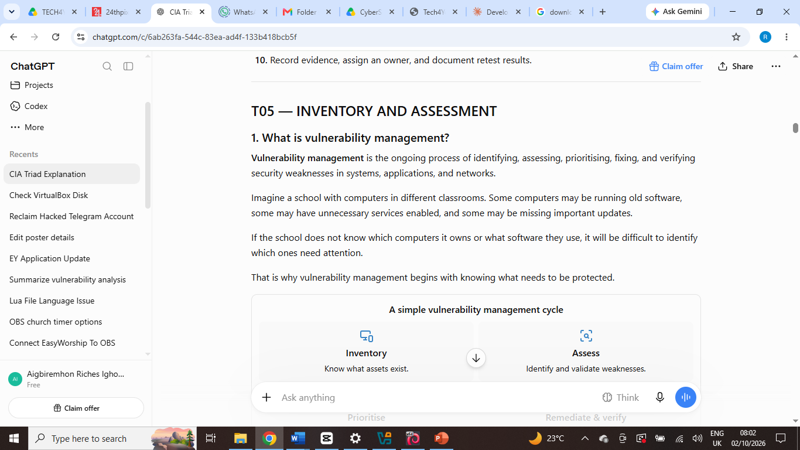

Slide 4
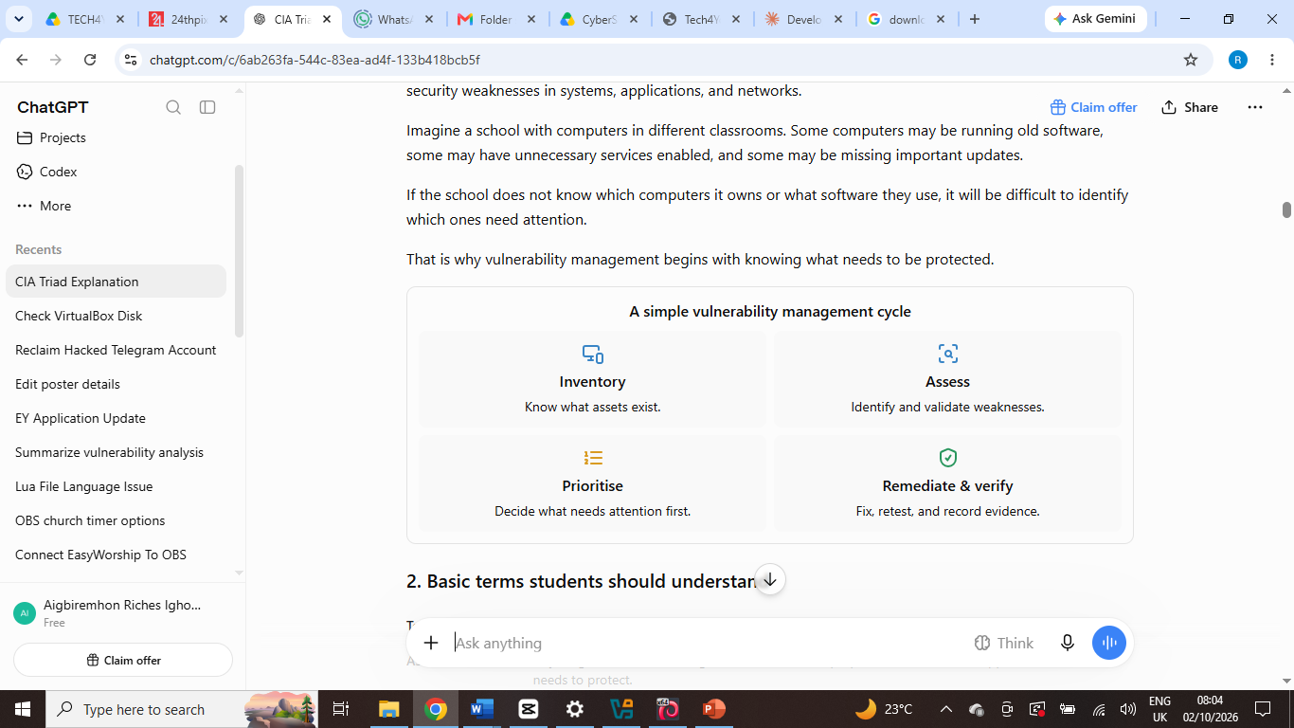

Slide 5
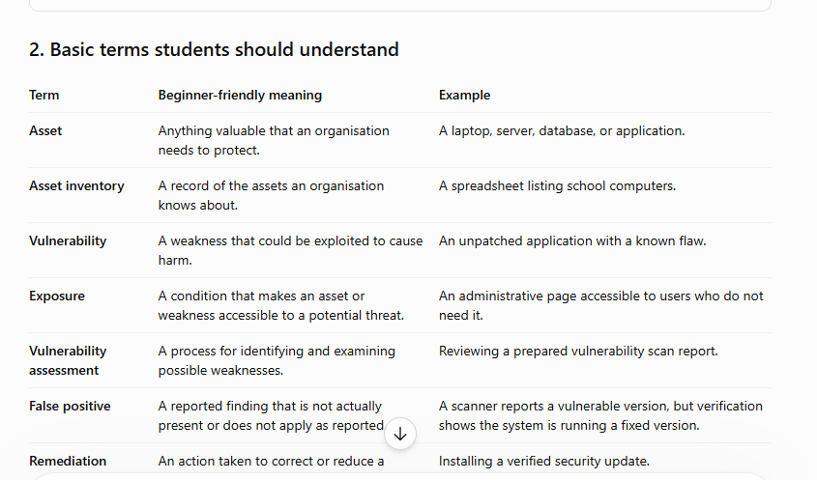

Slide 6
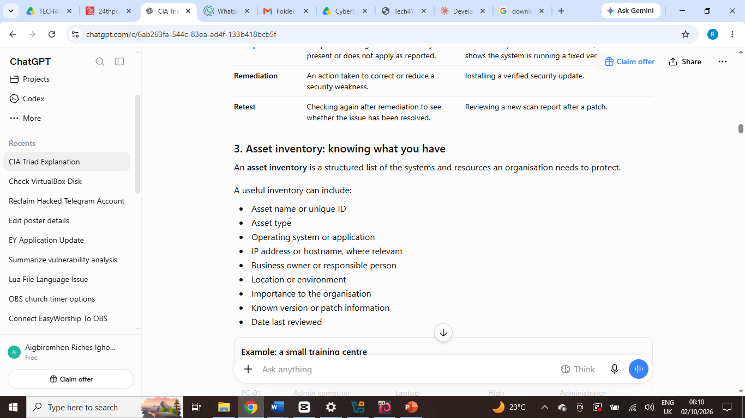

Slide 7
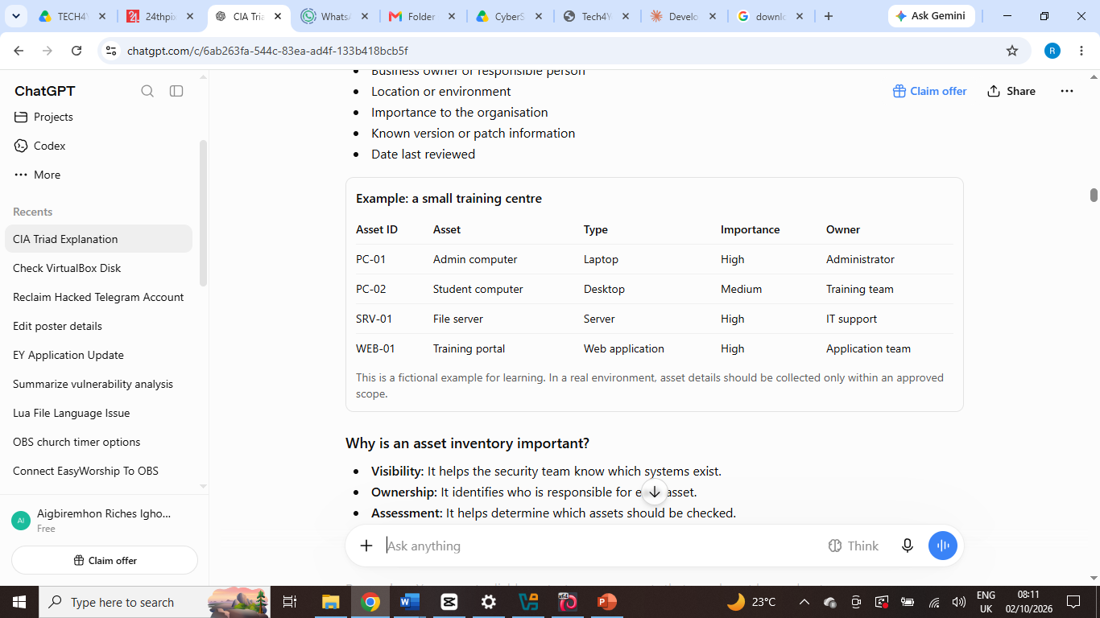

Slide 8
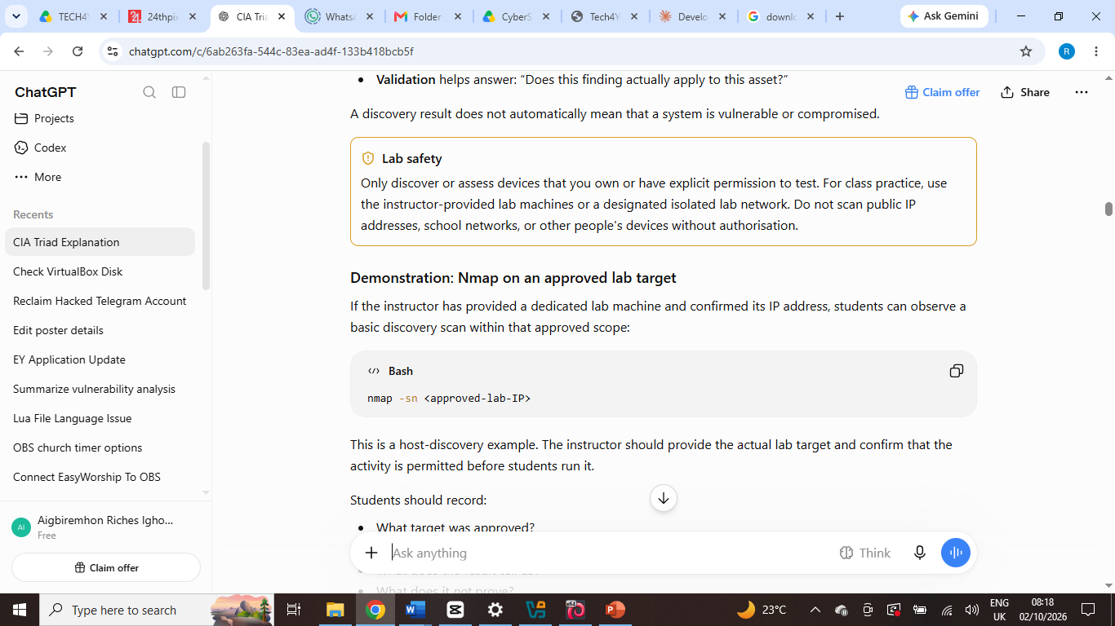

Slide 9
Quick Nmap Cheat Sheet
Command | Function
nmap TARGET | Basic scan
nmap -sn TARGET | Discover whether host is available
nmap -p 80 TARGET | Scan a specific port
nmap -p 22,80,443 TARGET | Scan selected ports
nmap -p 1-1000 TARGET | Scan a port range
nmap -sV TARGET | Detect service/version
sudo nmap -O TARGET | Attempt OS detection
sudo nmap -sV -O TARGET | Service + OS detection
nmap -sn NETWORK/24 | Discover hosts in an approved network
nmap -oN file.txt TARGET | Save results as text

Slide 10
T06 — PRIORITISATION AND REMEDIATION

Slide 11


Slide 12
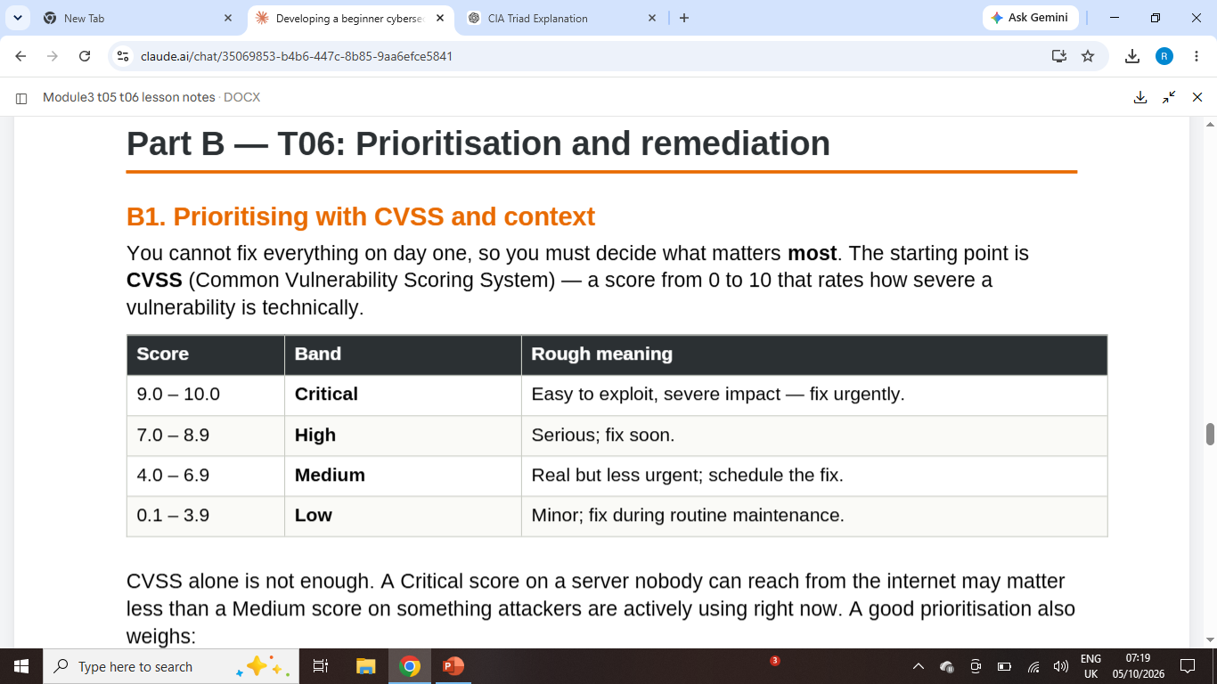

Slide 13
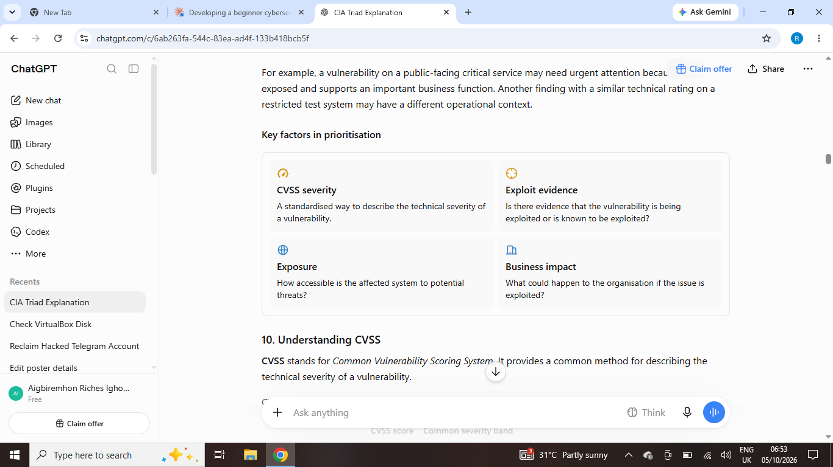

Slide 14
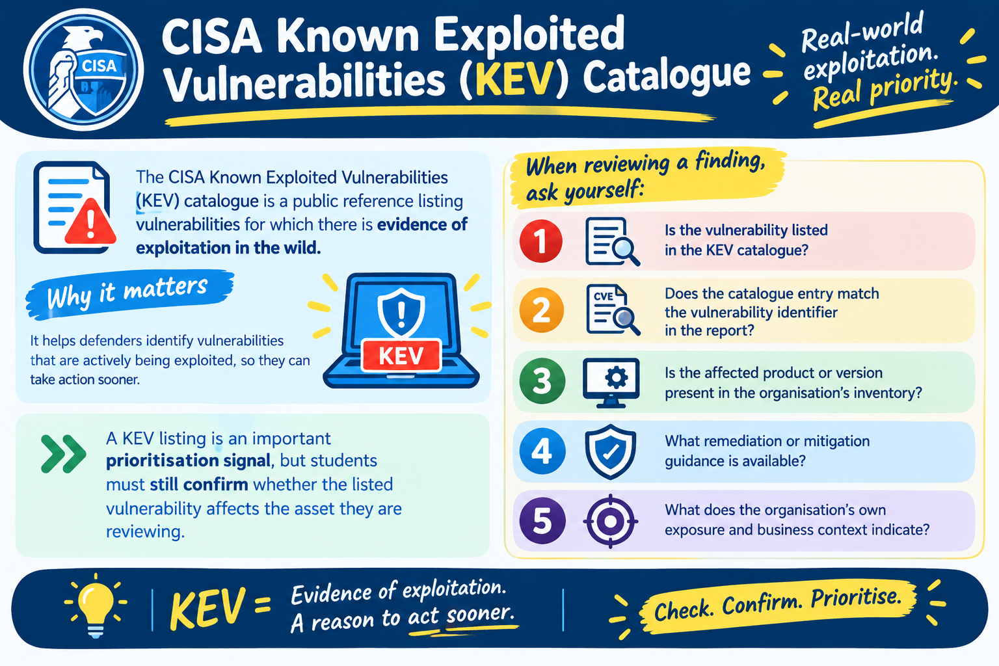

Slide 15
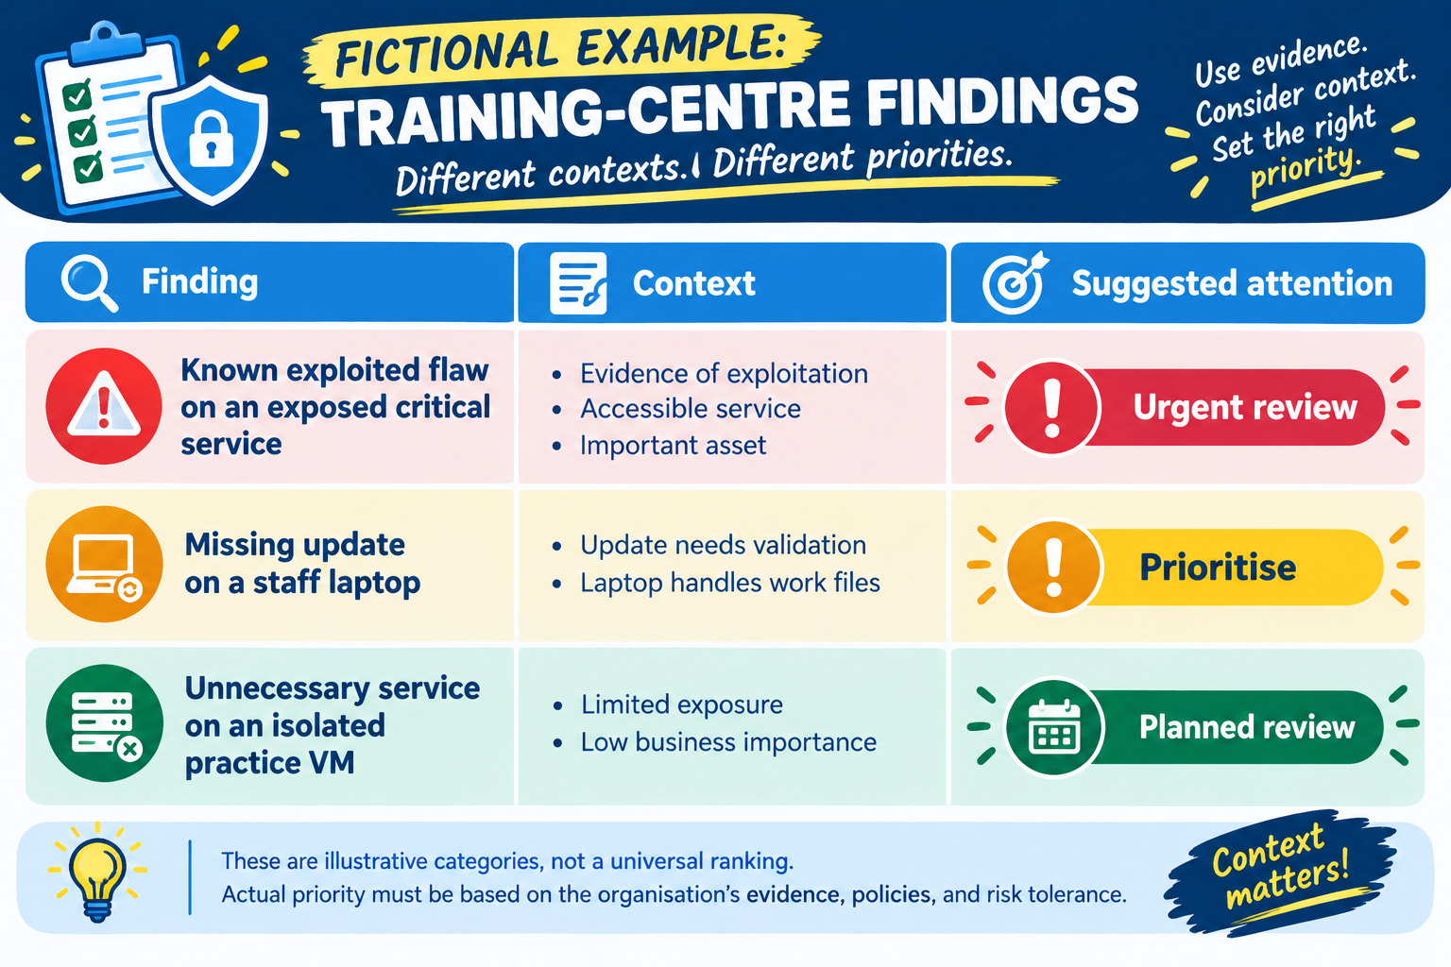

Slide 16


